Slide 1

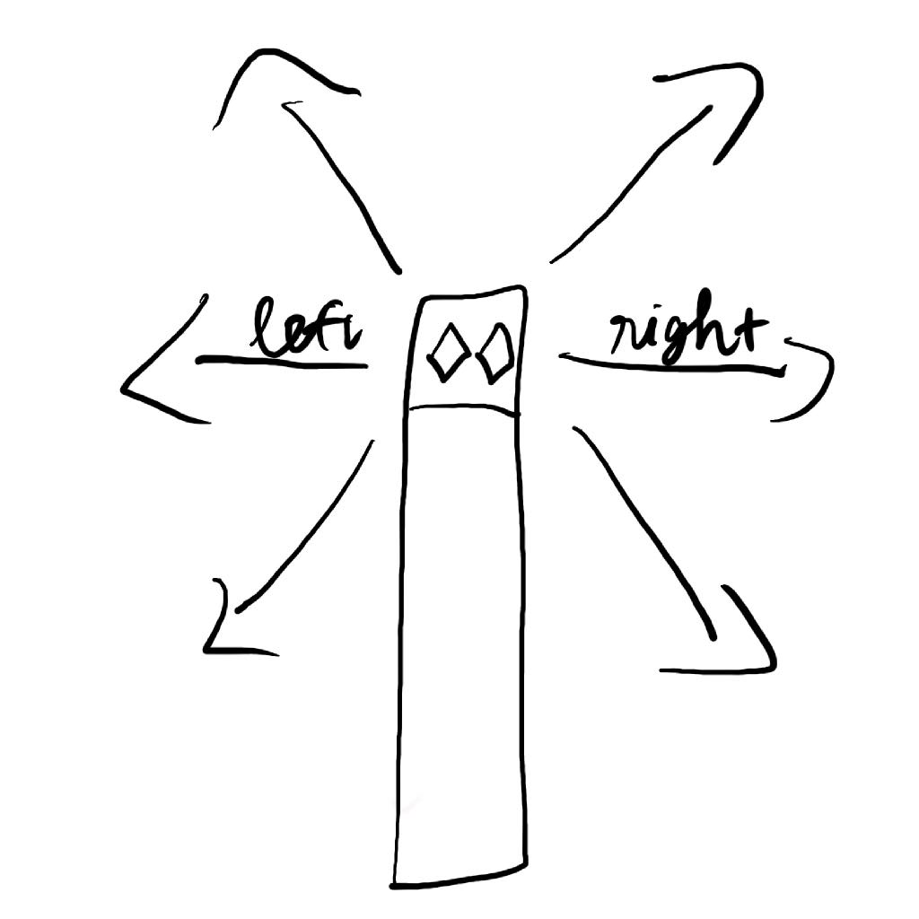
Snake Snape
Adding four more directions of movement besides left and right. Left diagonal up, right diagonal up, left diagonal down, and right diagonal down.

Slide 2
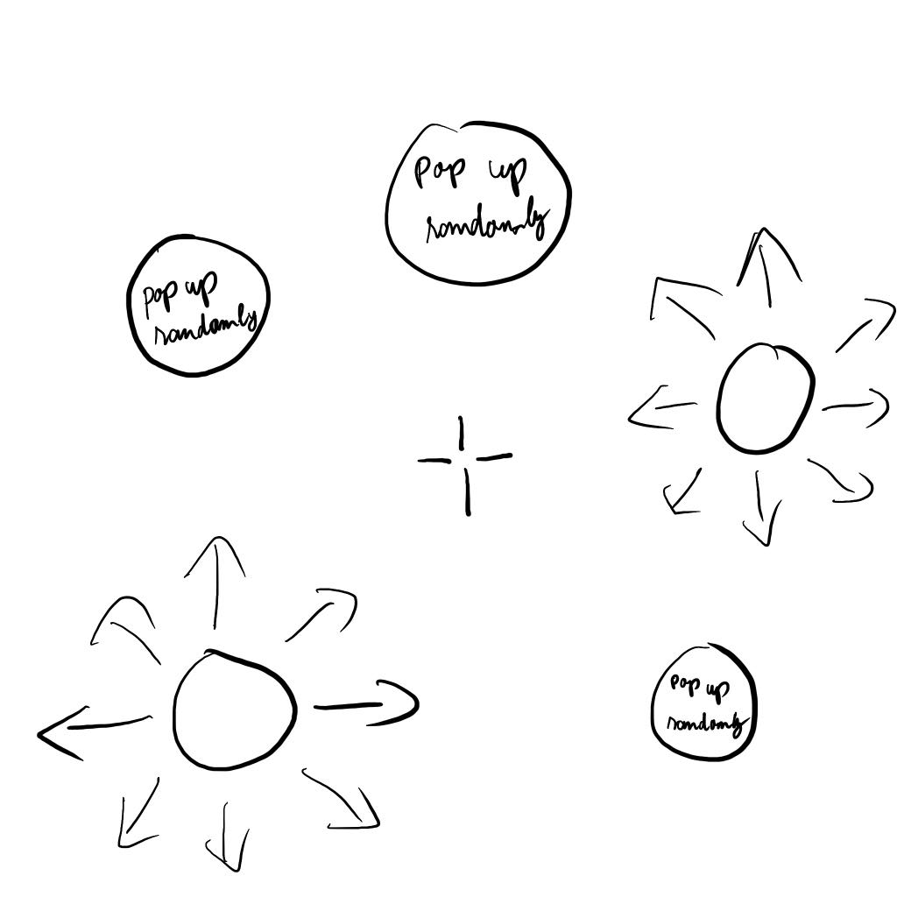
Rush Aim
An FPS game helps players to warm up their aiming skills like flicking, reflection, and tracking before jumping into other PFS games like Valorant or Counter-Strike.

Slide 3
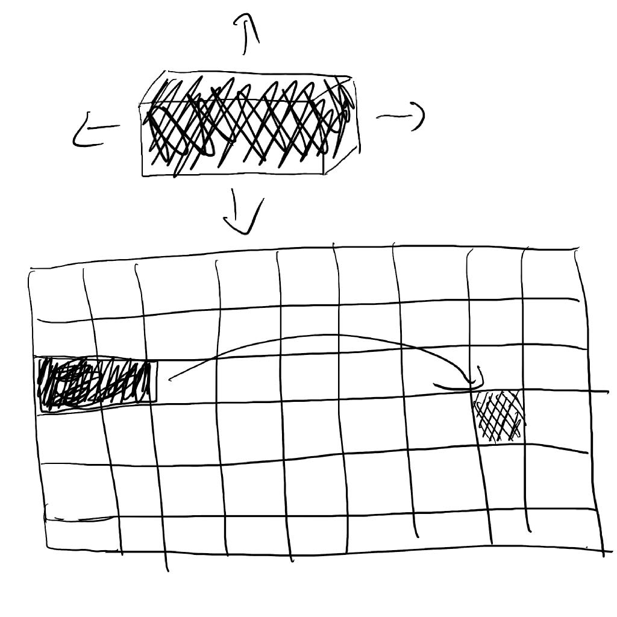
Fit The Holes
A puzzle game in which players have to move a cylindrical block to reach a square destination hole by rolling the block on a platform.

Slide 4
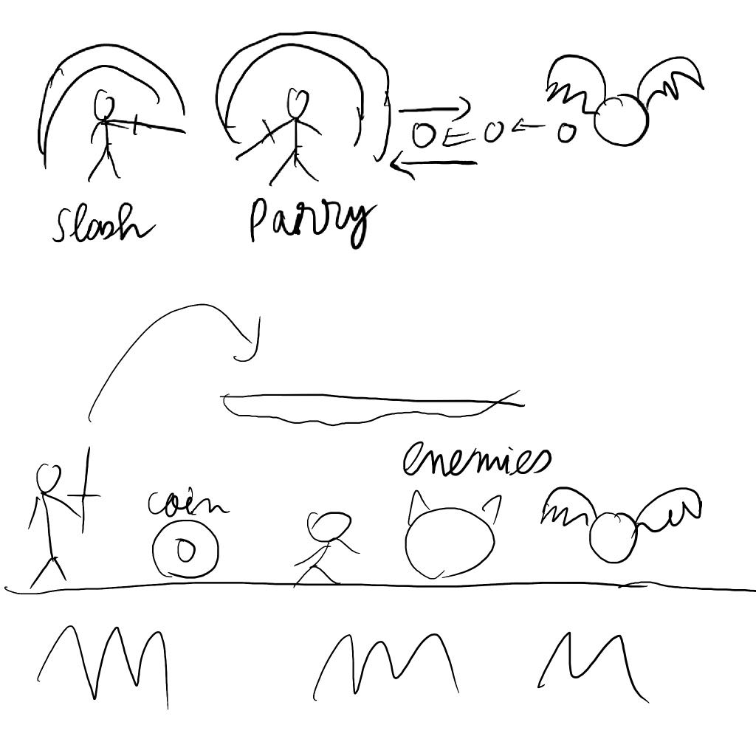
Darkinston
An action, adventure game which players can run, jump, swing their sword, collect coins, and buy items.

Slide 5
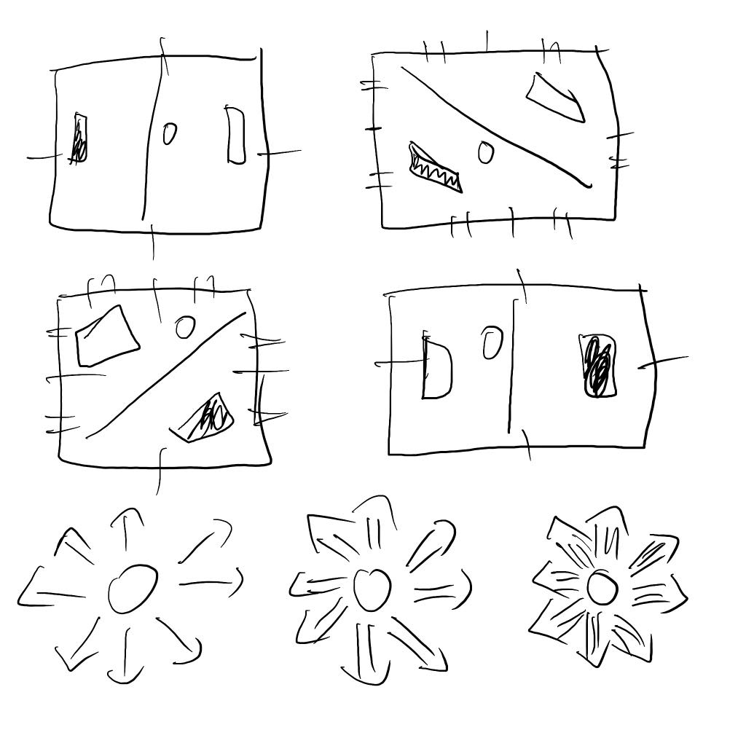
Pong Of Chaos
It’s a Pong game with more mechanisms. A Pong game will be 96.3s. The first 32.1s will be just like a regular classic Pong game. Next 32.1s, players will switch sides every 10.7s and the balls speed up twice. In the last 32.1s, players will switch sides every 5.35s and the ball will speed up thrice.

